Slide 1
AMAZONIA
PROPERTIES AVAILABLE FOR THE DATES OF COP30 IN BELÉM 2025

Slide 2
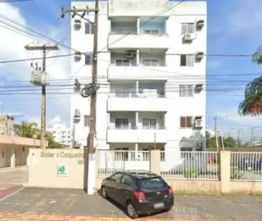
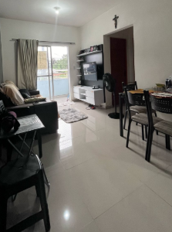
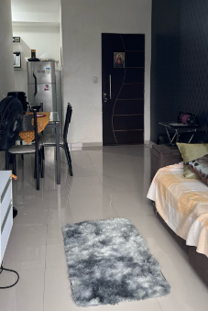
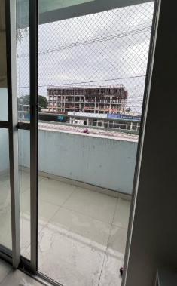
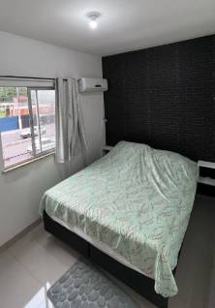
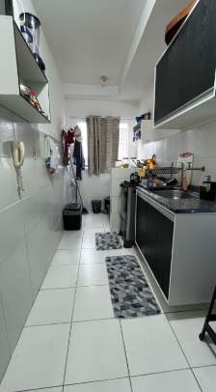
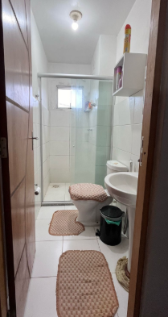
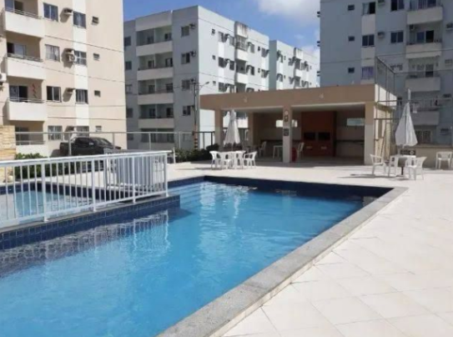
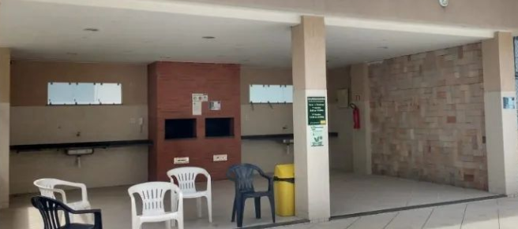
Location: Ananindeua-Pará Combined living room, balcony, kitchen, 2 bedrooms, bathroom, garage, swimming pool, gourmet area. Capacity: 4 guests Price for 14 days $10.000
3-seater sofa, dining table, TV, fan, double bed (cannot be exchanged), air conditioning, pillows, sheets, pillow, blackout curtain, 01 double mattress or single beds, towels, hygiene products, cleaning products, refrigerator, stove, microwave, blender, closet, airfryer, dishes and pans, laundry tub, clothesline, iron, laundry basket.

Slide 3
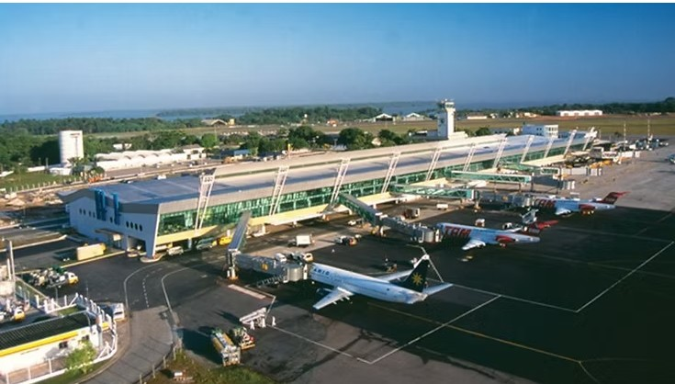
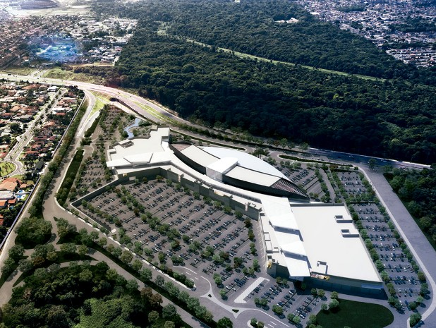
30 minutes from Shopping Grão Pará 35 minutes from the Airport, 38 minutes from Parque da Cidade (where the main events of Cop30 will take place)
Airport Grão Pará Shopping

Slide 4
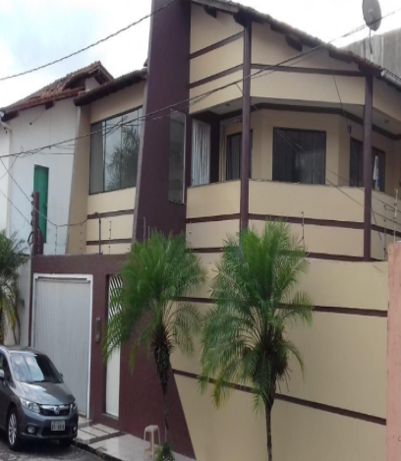
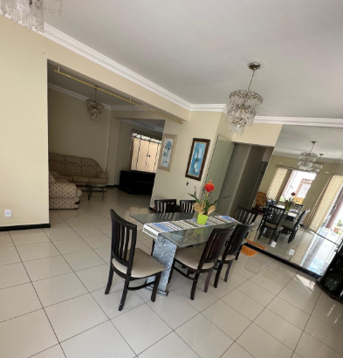
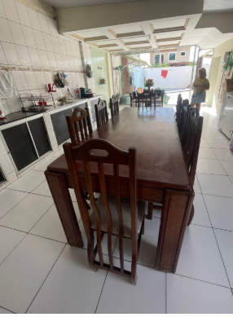
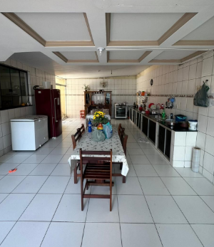
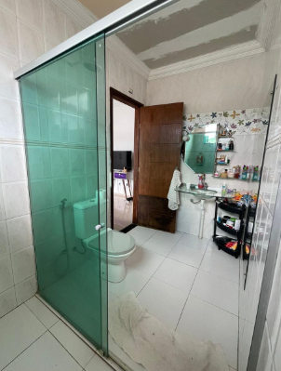
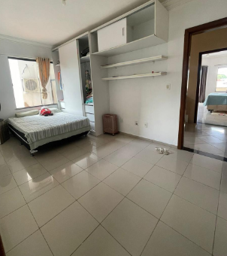
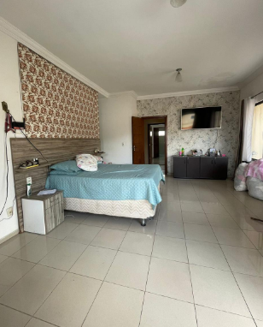
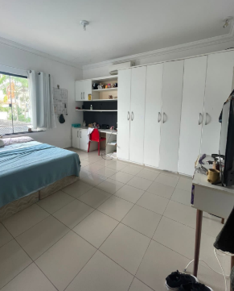
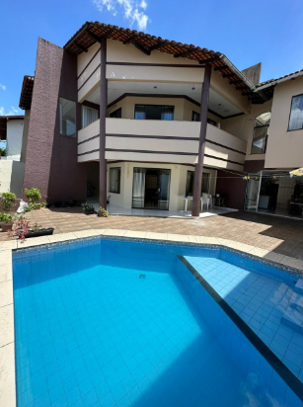
LARGE HOUSE Location:Parque verde, Belém-Pará. 2 adjoining rooms, 2 kitchens, 1 toilet, 5 bedrooms, 4 of which are suites, swimming pool, leisure area, garage. Capacity: 10 guests Price for 14 days: $ 30.800
2 sofas, TVs in the living rooms, 3 dining tables, sideboard, air conditioning in the bedrooms, TVs in the suites, sheets, towels, laundry, iron, washing machine, barbecue area, freezer, refrigerator, 2 stoves, air fryer, built-in cabinets, crockery, microwave, blender, mixer, coffee maker, cleaning supplies, toiletries.
Improvements: decoration, furniture for living space.
Included: cleaning and breakfast.

Slide 5
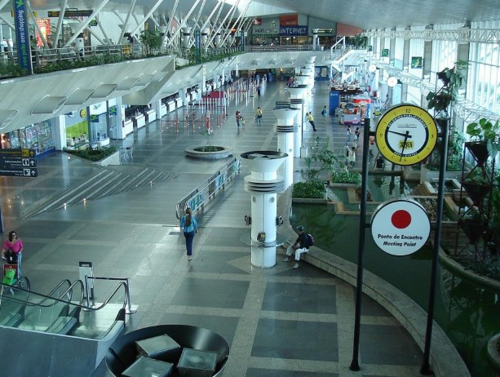
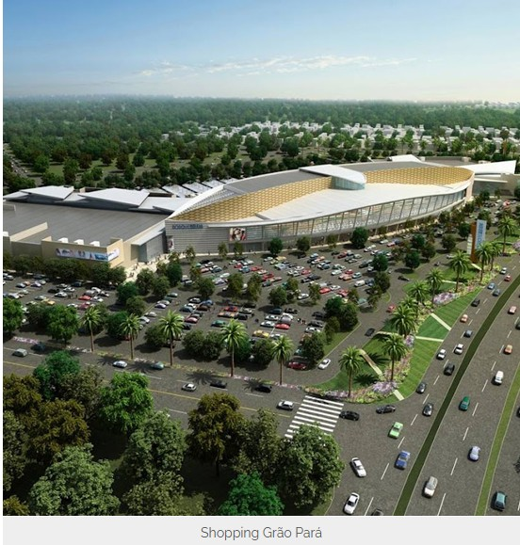
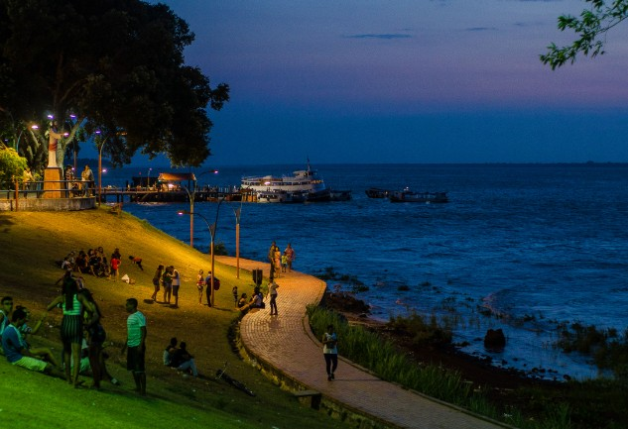
30 minutes from Shopping Grão Pará 35 minutes from the Airport, 38 minutes from Parque da Cidade (where the main events of Cop30 will take place) 14 minutes from Orla de Icoaraci. A place where you can enjoy delicious food, typical of Belém, as well as enjoy a delicious coconut water, all while enjoying a beautiful sunset. (The word "Icoaraci", which means "facing the sun" or "river sun", comes from the indigenous Tupi language).
Airport Shopping Grão Pará Icoaraci

Slide 6
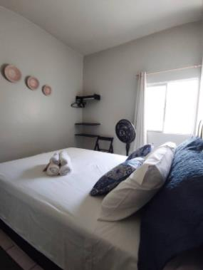
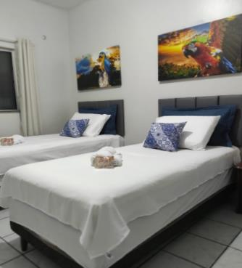
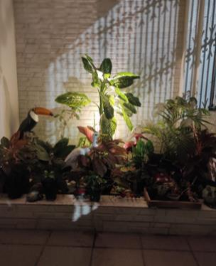
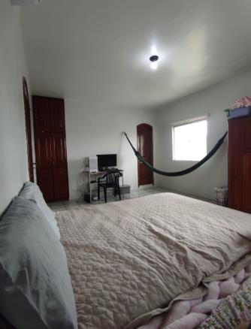
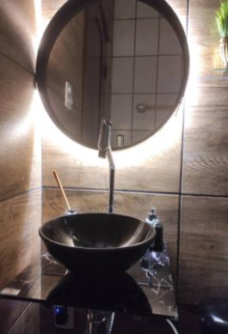
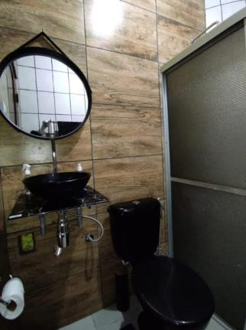
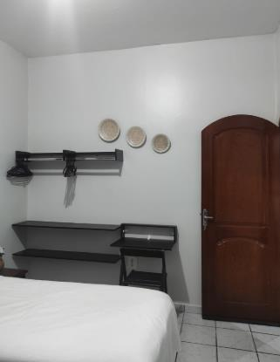
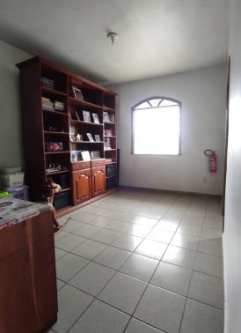
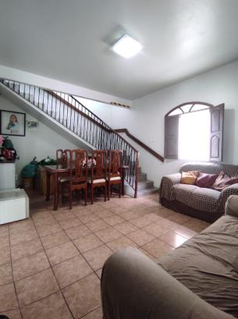
A BIG HOUSE COMPLETE Location: Mangueirão, Belém-Pará Capacity: 12 guests. 4 living rooms,4 suites, more 2 bedrooms, 2 kitchens, 2 bedrooms, 6 bathrooms, garage, balcony, backyard and side outdoor area. Price for 14 days: $ 36.000

Slide 7
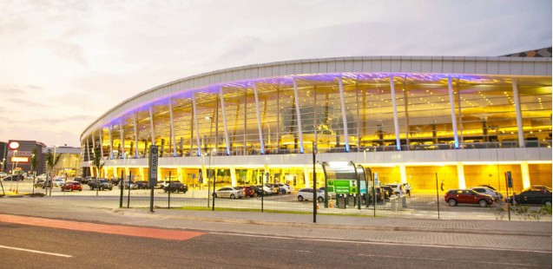
A BIG HOUSE COMPLETE
air conditioning in all rooms
full kitchen (stove, refrigerator, microwave, air fryer, sandwich maker, blender, electric kettle, water filter with bacteriological efficiency, pots, utensils, dishes), organic and regional hygiene products (soap, shampoo, conditioner), extra standard sheets and towels, comfortable pillows, space for smokers, air conditioning, clothes racks/wardrobe, regional decoration with paintings and ceramic objects from Marajoara, Wi-Fi, TV with streaming, fire extinguishers, fire alarm, outdoor camera, screens on the windows. Trash cans for recycled trash. Improvements: hammock, outdoor furniture (sun loungers), hanging chair, among others, electric shower and bathroom renovation. There are 2 double beds, but they can be exchanged for two single beds in each room, depending on the need.
Includes a regional breakfast table with several options of typical fruits and cleaning.
5 minutes from Shopping Grão Pará, 5 minutes from Estadio do Mangueirão ( Music Shows, as Coldplay, Green day and more).
7 minutes from the Airport,
8 minutes from Parque da Cidade (where the main events of Cop30 will take place)
Airport Shopping Grão Pará

Slide 8
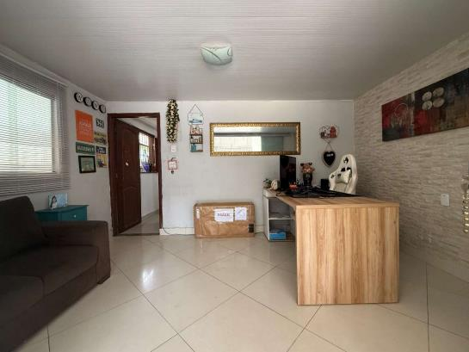
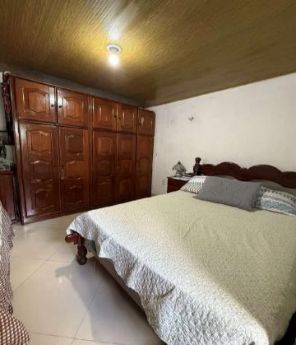
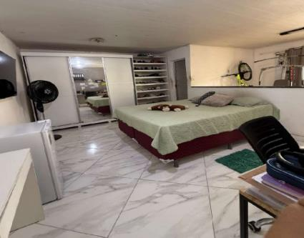
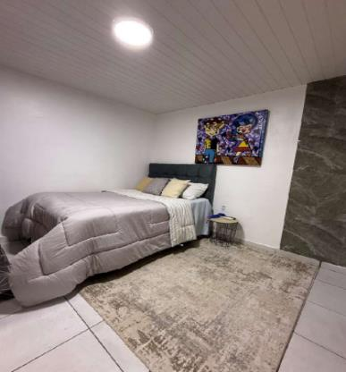
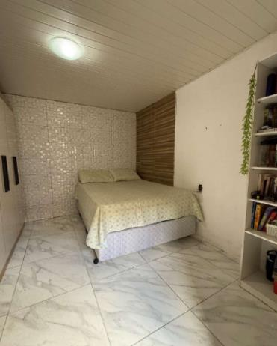
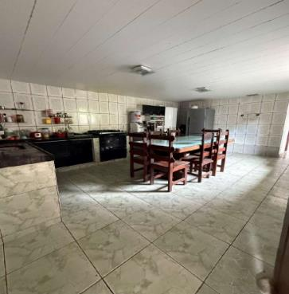
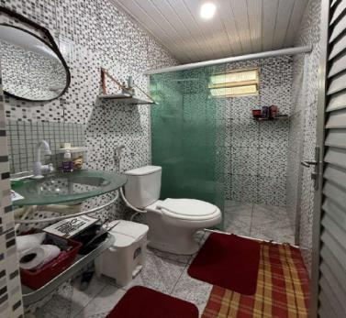
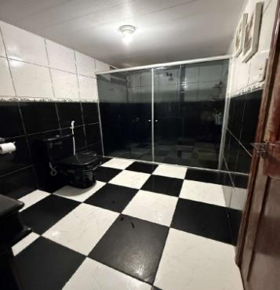
COMPLETE HOUSE Location: Icoaraci/Cruzeiro, Belém-Pará. Capacity: 8 guests House: Garage, living room, 3 bedrooms, shared kitchen, bathroom, laundry room, smoke area. Flat: 2 suites, 2 room bedroom, kitchen and bathroom. Price for 14 days: $25.000

Slide 9
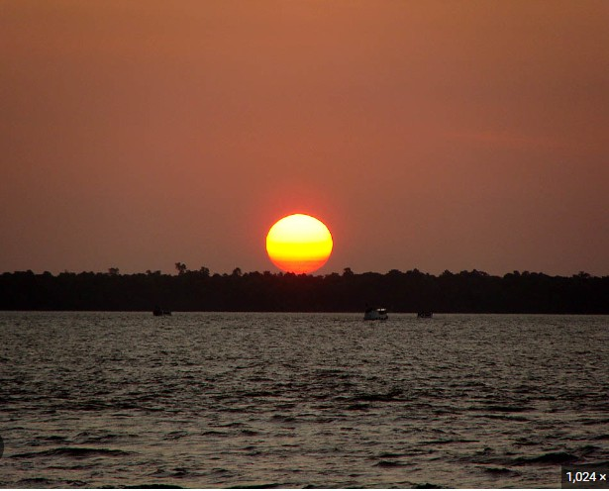
Wi-Fi, cable TV and Netflix, full kitchen (refrigerator, stove, microwave, blender, sandwich maker, airfryer, dishes, pots, utensils) Improvements: painting, decorative items, purchase of sofa bed, air conditioning. Bedroom 2: complete renovation, including wardrobe and two single beds or bunk beds. Outdoor gourmet area: complete renovation, with new flooring and painting, installation of sink and laundry, plus barbecue and inclusion of table and chairs. Flat: renovation to include full kitchen - minibar, microwave, airfryer, blender, stove, dishes and pots. Optional inclusion of single bed. Breakfast included.
30minutes from Shopping Grão Pará 30 minutes from the Airport, 35 minutes from Parque da Cidade (where the main events of Cop30 will take place) 5 Minutes from Orla de Icoaraci. A place where you can enjoy delicious food, typical of Belém, as well as enjoy a delicious coconut water, all while enjoying a beautiful sunset. (The word "Icoaraci", which means "facing the sun" or "river sun", comes from the indigenous Tupi language)
Sunset in Icoaraci

Slide 10
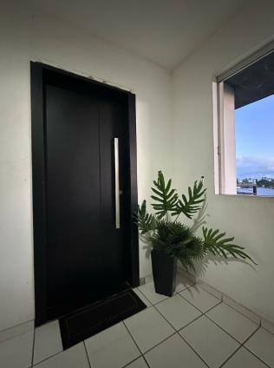
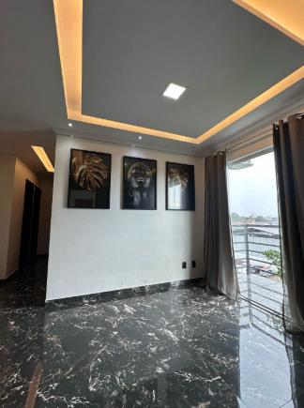
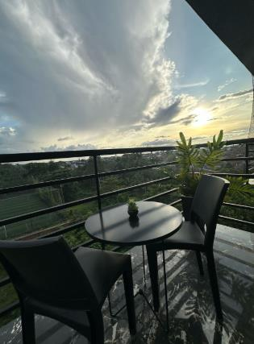
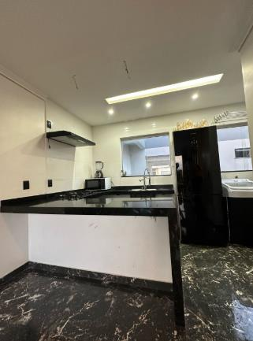
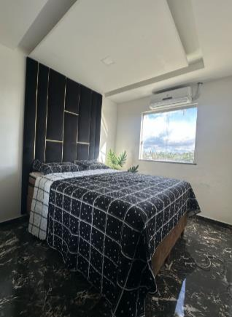
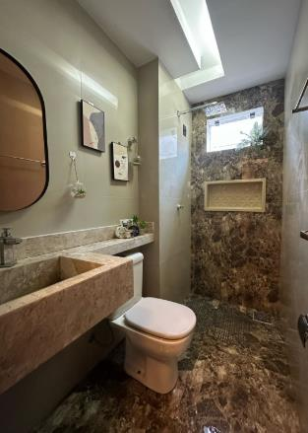
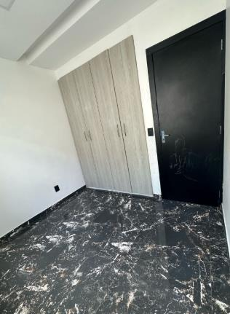
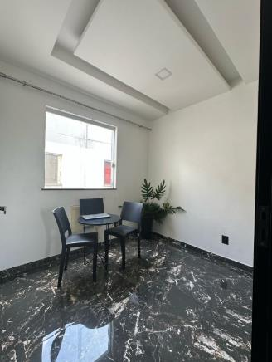
Location: Ananindeua-Pará Capacity: 4 guests 3 bedrooms, 1 bathroom, kitchen, laundry room, 1 living room, balcony, and 1 parking space, 24-hour security camera, leisure area (adult and children's pool, barbecue, party room, gym, games room, court) Price for 14 days: $12.000

Slide 11
No elevator. 65” TV, double bed, 2 bedrooms have central air conditioning, built-in wardrobe, the other bedroom has a fan, built-in stove, microwave, blender, refrigerator, sugar, 1 table and 2 chairs on the balcony. The apartment is new, all in cove with yellow lighting, porcelain tiles and new paint. Improvements: 3-seater sofa, 1 air conditioner, rug, TV, plants, lamp, regional decorative items, desk, curtains, rug, 50” TV, 1 single bed, 1 trundle bed, small closet, kitchen (modular furniture), chairs, wine cellar space, sandwich maker, water filter, dishes, full gas, basic food items and regional fruits in the first 3 days, ironing and iron, electric shower, shower stall, larger mirror, personal hygiene items, sheets, towels. Includes breakfast, daily cleaning, conditioner and regional exfoliants, 100% natural from our region.
35 minutes from Shopping Grão Pará. 38 minutes from the Airport. 38 minutos minutes from Parque da Cidade (where the main events of Cop30 will take place).
Airport Shopping Grão Pará

Slide 12
APARTMENT IN CITY CENTER Location: Umarizal, Belém-Pará Capacity: 6 guests Price for 14 days: $ 25.000
Air conditioning, TV, full kitchen - minibar, microwave, airfryer, blender, stove, dishes and pots. Optional inclusion of single bed.

Slide 13
10 minutes from Shopping Boulevard. 25 minutes from the Airport. 22 minutes from Parque da Cidade (where the main events of Cop30 will take place). 12 minutos from the Mercado-ver- o peso
Estação das Docas Boulevard Shopping Mercado-ver- o peso

Slide 14
NEW APARTMENT Localização: Belém - Pará Capacity: 4 Price for 14 days: $ 10.000

Slide 15
12 minutes from Shopping Grão Pará 17 minutes from the Airport. 19 minutes from Parque da Cidade (where the main events of Cop30 will gonna happen). 30 minutos from the Mercado-ver- o peso
Shopping Grão Pará
Mercado-ver- o peso
Airport

Slide 16
APARTMENT Location: Parque Verde, Belém-Pará. Capacity: 4 guests Living room, dining room, 3 bedrooms, 1 bathroom, kitchen/outdoor area, garage. Price for 14 days: $ 10.000

Slide 17
10 minutes from Parque Shopping. 25 minutes from the Airport. 25 minutes from Parque da Cidade (where the main events of Cop30 will take place). 5 minutes from the Formosa Supermarket and 10 minutes from the do Mangueirão Stadium.
Mangueirão Stadium
Supermarket and Magazine Parque Shopping.

Slide 18
Location: City Center, Belém-Pará Capacity: 4 guests Price for 14 days: $ 16.000

Slide 19
10 minutes from Shopping Boulevard. 25 minutes from the Airport. 22 minutes from Parque da Cidade (where the main events of Cop30 will take place). 12 minutos from the Mercado-ver- o peso
Estação das Docas
Shopping Boulevard
Mercado-ver- o peso

Slide 20
BIG HOUSE Location: Belém-Pará Garage, garden, 2 living rooms, 1 dining room, kitchen, 4 suites, outdoor area. Capacity: 8 people Price for 14 days: $ 40.000 air conditioning, TV, full kitchen - minibar, microwave, airfryer, blender, stove, dishes and pots. Optional inclusion of single bed.

Slide 21
12 minutes from Shopping Grão Pará. 14 minutes from the Airport. 5 minutes from Parque da Cidade (where the main events of Cop30 will take place). 30 minutos from the Mercado-ver- o peso
Airport
Shopping Grão Pará
Mercado-ver- o peso

Slide 22
APARTMENT Location: Ananindeua-Pará Living room, dining room, 1 suite, 2 bedrooms, 2 bathrooms. Capacity: 4 guests Price for 14 days: $ 10.000 air conditioning, TV, full kitchen - minibar, microwave, airfryer, blender, stove, dishes and pots.

Slide 23
35 minutes from Shopping Grão Pará. 40 minutes from the Airport. 30 minutes from Parque da Cidade (where the main events of Cop30 will gonna happen). 30 minutes from the city center.
Shopping Grão Pará
Airport

Slide 24
HOUSE Location:Parque Verde, Belém-Pará Garage, patio, living room, kitchen, 1 suite, 3 bedrooms, 2 bathrooms, laundry room and backyard. Flat: living room, kitchen, bedroom and bathroom. Capacity: 6 Price for 14 days: $ 10.000

Slide 25
The house is under renovation, 200m², 2 sofas, 2 TVs, 2 dining tables, double bed, wardrobe, curtains, sheets, towels, refrigerator, stove, utensils, pans, sandwich maker and microwave. Improvements: air conditioning, electric shower, airfryer, water filter.
10 minutes from Parque Shopping. 25 minutes from the Airport. 22 minutes from Parque da Cidade (where the main events of Cop30 will take place).
5 minutes from the Supermarket and Magazine.
Parque Shopping
Supermarket and Magazine

Slide 26
APARTMENT Location: São Braz, Belém - Pará 1 suite and 2 bedrooms and bathrooms, L-shaped living room with sofa bed and kitchen . Capacity: 4 guests Price for 14 days: $ 15.000

Slide 27
15 minutes from Shopping Boulevard. 25 minutes from the Airport. 20 minutes from Parque da Cidade (where the main events of Cop30 will take place). 25 minutos from the Mercado-ver- o peso air conditioning, TV, full kitchen - minibar, microwave, airfryer, blender, stove, dishes and pots.
Shopping Boulevard.
Mercado-ver- o peso

Slide 28
Located: City Center, Belém - Pará. Capacity: 40 guests Price for 14 days: $ 70.000

Slide 29
Big hostel
With a total area of ​​590 m2, the property is ideal for families or groups of friends seeking a high-quality leisure and relaxation experience.
Accommodation
The residence has 7 spacious and airy suites. The kitchen is equipped with all the necessary household amenities and offers a separate service area. The house is fully air-conditioned.
Accommodation Capacity
The residence is designed to comfortably accommodate 40 people.
The area offers a complete leisure space, with adult and children's game tables, a green area with two barbecues. Guests can enjoy a variety of outdoor activities while enjoying the natural beauty of the surroundings.
Additional features
We will have a 24-hour security and camera circuit
Proximity to shops, restaurants, shopping malls, squares and the river.
Note: The distance from the house to the convention center where the COP 30 event will be held is 3.3 km, that is, a 12-minute drive away.

Slide 30
City center.
10 minutes from Estação das Docas.
10 minutes from Shopping Boulevard.
20 minutes from the Airport. 20 minutes from Parque da Cidade (where the main events of Cop30 will take place).
Shopping Boulevard Estação das Docas Mercado-ver- o peso

Slide 31
located on Rui Barbosa in a central area of ​​Belém, in the Reduto neighborhood. The building has 4 floors and does not have an elevator. The apartment is on the first floor.
Close to the Boulevard Shopping Mall and the best restaurants.
The property has a usable area of ​​108m2.
It has 3 spacious, airy bedrooms, all with air conditioning.
Bedroom 1: with a king-size bed, built-in wardrobe and TV.
Bedroom 2: with a double box bed, also with built-in wardrobe and TV.
Bedroom 3: with 2 single beds, with a small wardrobe, a bookcase and TV.

Slide 32
Location: City center, Belém - Pará Capacity: 6 guests Price for 14 days: $ 30.000 air conditioning, TV, full kitchen - minibar, microwave, airfryer, blender, stove, dishes and pots.

Slide 33
12 minutes from Shopping Boulevard. 35 minutes from the Airport. 30 minutes from Parque da Cidade (where the main events of Cop30 will take place). 15 minutos from the Mercado-ver- o peso
Airport Shopping Boulevard

Slide 34
APARTMENT Location: Batista Campos, Belém - Pará 2 bedrooms, living room, kitchen, bathroom and balcony Capacity: 4 guests Price for 14 days $ 30.000

Slide 35
15 minutes from Patio Shopping 40 minutes from the Airport, 5 minutos from the Praça Batista campos. 35 minutes from Parque da Cidade (where the main events of Cop30 will take place). 15 minutos from the Mercado-ver- o peso air conditioning, TV, full kitchen - minibar, microwave, airfryer, blender, stove, dishes and pots.
Batista Campos square

Slide 36
Location: Marambaia, Belém - Pará Capacity: 6 guests 3 bedrooms Price for 14 days: $ 30.000 air conditioning, TV, full kitchen - minibar, microwave, airfryer, blender, stove, dishes and pots.

Slide 37
15 minutes from Shopping Boulevard. 35 minutes from the Airport. 30 minutes from Parque da Cidade (where the main events of Cop30 will take place). 15 minutos from the Mercado-ver- o peso and Estação das Docas.
Airport Shopping Boulevard.

Slide 38
Location: Parque Guajará, Belém - Pará Capacity: 6 guests 3 bedrooms Price for 14 days $ 30.000

Slide 39
15 minutes from Parque Shopping. 25 minutes from the Airport. 25 minutes from Parque da Cidade (where the main events of Cop30 will take place). 10 minutes from the Supermarket and Maganize.
Supermarket and Magazine Parque Shopping

Slide 40
LARGE HOUSE SHARED WITH HOST -Location: Umarizal, Belém-Pará. Garage, 2 living rooms, 1kitchen, 2 bathroom, 4 bedrooms, 1 external suite, external area/backyard. Capacity: 6 guests Price for 14 days: $ 12.000

Slide 41
City center 10 minutes from Estação das Docas, 5 minutes from Praça Brasil 10 minutes from Shopping Boulevard 30 minutes from the Airport. 30 minutes from Parque da Cidade (where the main events of Cop30 will take place). city center
Estação das Docas
Brasil Square
amazontourtrips@gmail.com
 +55 91 98140-8086 98180-6327

